Slide 1




Peer-to-Peer File Sharing System
Presented To
Sharifur Rahman
Lecturer , Department Of CSE
Green University of Bangladesh
1
Notes:
Links:
https://pixabay.com/vectors/connection-internet-digital-network-4166469/

Slide 2


Our Team
Moriam Khatun
221002197
Md Sohel
221002173
Meherun Nesa Enta
221002197
2

Slide 3
Table of Contents
Introduction
Features of the System
Technologies Used
User Interface (UI)
How It Works
Future Improvements
Conclusion
3

Slide 4
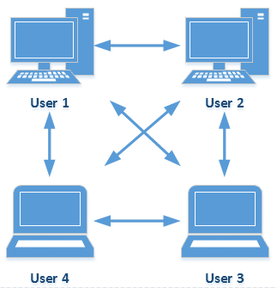
Introduction
What is a Peer-to-Peer (P2P) File Sharing System?
4
Notes:
Links:
https://www.pexels.com/photo/photo-of-people-looking-on-laptop-3182801/

Slide 5

Objective of the Project
To develop a simple, secure, and efficient file-sharing system between peers using Java and Swing.
5
Notes:
Links:
https://www.pexels.com/photo/photo-of-people-looking-on-laptop-3182801/

Slide 6
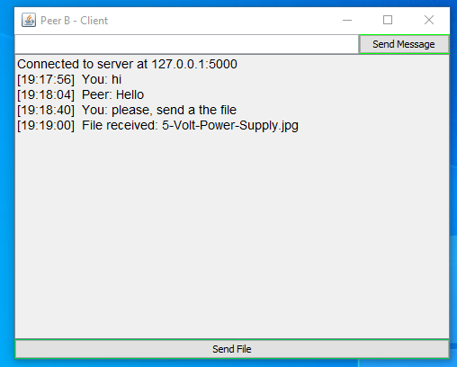
Features of the System
Message Communication
File Transfer
Peer-to-Peer Connection
6

Slide 7
Technologies Used
Java:
Programming language used for the backend logic.
Swing:
Used for creating the user interface.
Sockets:
For establishing network communication between peers.
7

Slide 8
User Interface (UI)
Message Field
History
.
Choose and Select File
8

Slide 9
How It Works
Start Server:
One peer acts as the server and listens on a specified port.
Connect to Peer:
The other peer connects to the server using the IP address and port.
Send/Receive Files:
Users can send and receive files once the connection is established.
File Transfer:
Files are transferred in chunks, and the receiver saves the file in the designated folder.
Chat:
Messages can be exchanged while the files are being sent.
9

Slide 10
Future Improvements
File Encryption:
Add security by encrypting the files during transfer.
File Integrity Check:
Implement checksums or hashes to verify the integrity of transferred files.
Multiple Peer Connections:
Allow more than two peers to share files in a decentralized network.
User Authentication:
Add user login and authentication for enhanced security.
10

Slide 11
Conclusion
The Peer-to-Peer File Sharing System allows direct file exchange between users.
Simple, efficient, and built using core networking concepts in Java.
Future improvements could enhance the system's capabilities and security.
11
Notes:
Links:
https://www.pexels.com/photo/photo-of-people-looking-on-laptop-3182801/

Slide 12
Thank You!
Any Question?
12
Notes:
Links:
https://pixabay.com/vectors/connection-internet-digital-network-4166469/

